Slide 1
Artificial intelligence
Lecture-3
Problem solving by Searching
Syed Zubair ali

Slide 2
Problem solving by Searching
An agent with several immediate options of unknown value can decide what to do by first examining future actions that eventually lead to states of known value.

Slide 3
Problem solving by Searching
A problem can be defined formally by five components:
The initial state that the agent starts in. For example, the initial state for our agent in Romania might be described as In(Arad).
A description of the possible actions available to the agent. Given a particular state s, ACTIONS(s) returns the set of actions that can be executed in s. We say that each of these actions is applicable in s.
A description of what each action does; the formal name for this is the transition model, specified by a function RESULT(s, a) that returns the state that results from doing action a in state s.
The goal test, which determines whether a given state is a goal state.
A path cost function that assigns a numeric cost to each path.

Slide 4

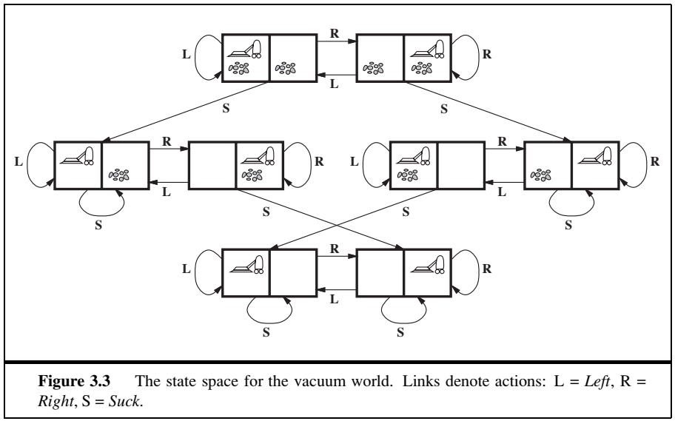
Problem solving by Searching

Slide 5
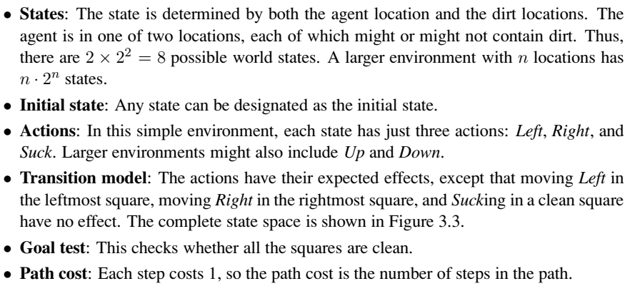
Problem solving by Searching

Slide 6
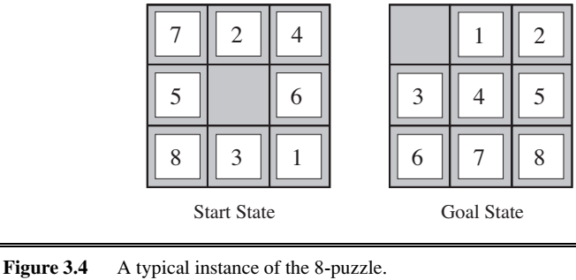
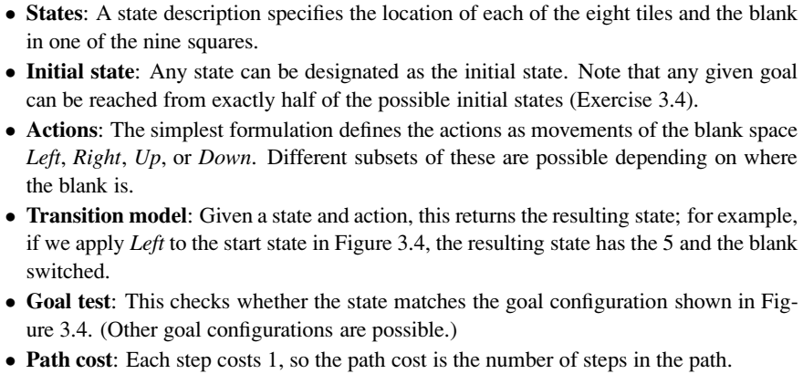
Problem solving by Searching

Slide 7
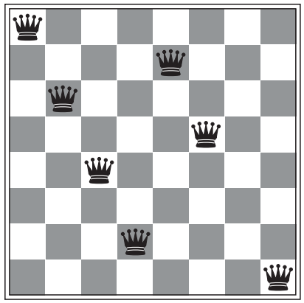
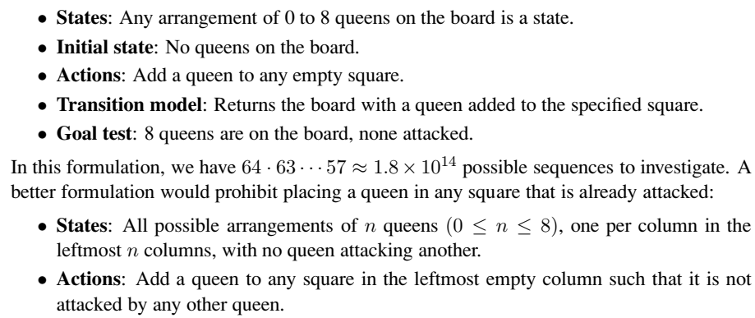
Problem solving by Searching

Slide 8
Problem solving by Searching

Slide 9
Thank you

